Slide 1
Noise-Aware Adaptive Beamforming for Intelligent Reflecting Surface-Assisted Wireless Communications
Vellore Institute of Technology, Chennai
School of Electronics Engineering (SENSE)
Guide: Dr. Kuldeep Yadav
Soham Landge – 23BLC1130 | Pulkit Bathwal – 23BLC1147 | Dhruv Rathi – 23BLC1164
Guide's Signature: ______________________

Slide 2
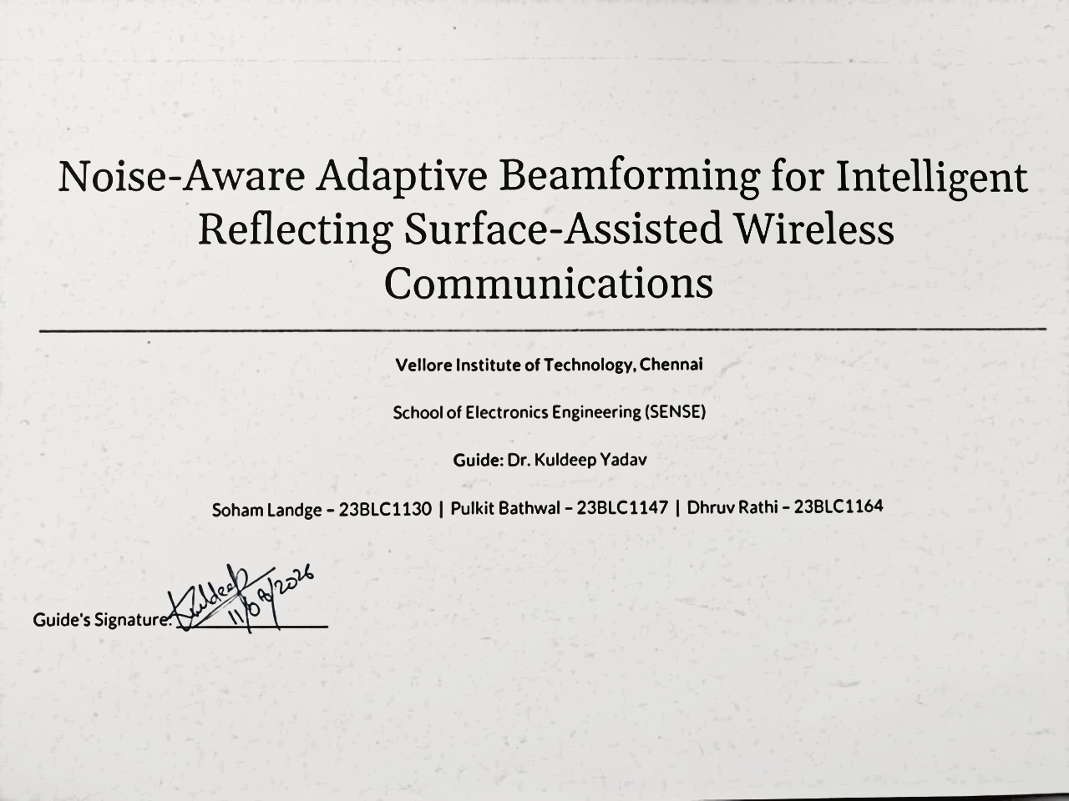

Slide 3
Introduction
mmWave communication enables high data rates but suffers from severe blockage and signal attenuation in NLoS environments.
Intelligent Reflecting Surfaces (IRS) can mitigate this issue by intelligently redirecting signals and creating virtual NLoS links.
Effective IRS beamforming requires accurate Channel State Information (CSI).
In practice, CSI is affected by pilot noise, limited pilot length, and varying SNR conditions.
Existing approaches often assume perfect CSI and idealized IRS phase control, creating a gap between theory and practical deployment.
This work investigates a noise-aware GNN-based beamforming framework designed to operate under realistic CSI conditions and discrete IRS phase constraints.

Slide 4
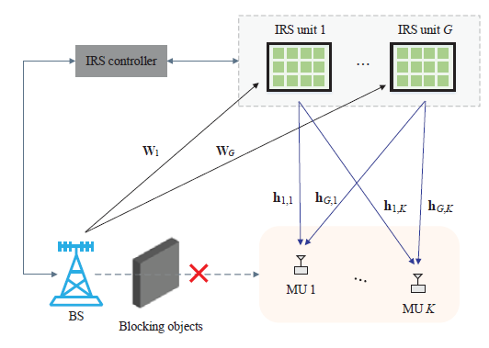
Problem Overview
mmWave signals suffer severe blockage in non-line-of-sight (NLoS) scenarios.
Intelligent Reflecting Surfaces (IRS) mitigate propagation attenuation by using passive elements to redirect reflected signals, creating virtual NLoS links through joint beamforming.

Slide 5
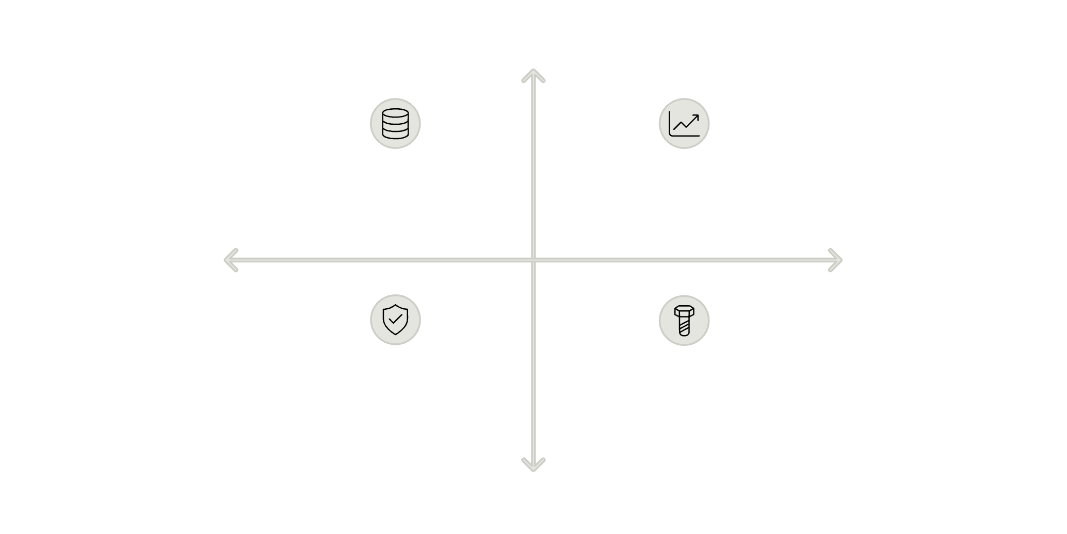
Challenges faced for calculating CSI
Low Noise
More Data , Better CSI
Less Data, Improved CSI
Accurate Channel State Information (CSI) is essential for beamforming, but passive IRS cannot measure channels directly.
Short Pilot Length
Long Pilot Length
More data, noisy CSI
Less data , Better CSI
High Noise
Long Pilot Sequences
Noisy Pilots
Reduce data transmission efficiency
Degrade beamforming decisions

Slide 6
Research Claims & Scope
Clear delineation of what this research investigates .
What We Will Investigate
Robustness under noisy pilots
Noise-aware learning effectiveness
Discrete phase shift compatibility

Slide 7
Existing Approaches
Paper Type | Paper Reference | Core Contribution | Why We Use It
Optimization Baseline | Q. Wu & R. Zhang (IEEE TWC 2019) | Classical Alternating Optimization (AO) joint beamforming. | Provides our theoretical upper bound baseline under perfect channel knowledge.
DL Base Paper 1 | Y. Ahn & B. Shim (IEEE ICTC 2021) | Direct Deep Neural Network (DNN) beamformer mapping. | Proves neural networks can predict beamforming parameters faster than iterative solvers.
Landmark Base Paper 2 | T. Jiang et al. (IEEE JSAC 2021 / arXiv:2009.14404) | Implicit Channel Estimation using Graph Neural Networks (GNN). | Provides our primary GNN architecture for processing short pilot bursts without matrix reconstruction.

Slide 8

Proposed Methodology
A noise-aware Graph Neural Network that learns directly from noisy pilots, trained across multiple noise levels, with discrete phase-aware learning.
Noise-Aware GNN
IRS Phase Config
Neural network processes signals.
Calculates surface phase shifts.
Noisy Pilots
Beamforming Weights
Initial signal transmission with noise.
GNN determines antenna weights.
This pipeline bridges the gap between theoretical optimization and practical IRS deployment under realistic channel estimation conditions.

Slide 9
Bridging Theory and Practice
Current Assumptions
Practical Reality
Perfect CSI
Continuous phase shifts
High SNR pilots
Noisy CSI
Discrete phase shifts
Variable SNR conditions
This gap motivates a noise-aware learning framework that bridges theory and practice.

Slide 10
Implementation Roadmap
Five sequential phases from system simulation through optional quantization-aware extensions.
Phase 1
IRS channel simulation environment
Phase 2
Classical and AI baseline implementation
Phase 3
Noise-aware GNN training pipeline
Phase 4
Evaluation across SNR and pilot configurations

Slide 11
References
[1] Q. Wu and R. Zhang, “Intelligent Reflecting Surface Enhanced Wireless
Network via Joint Active and Passive Beamforming,” IEEE Transactions
on Wireless Communications, vol. 18, no. 11, pp. 5394–5409, Nov. 2019,
doi: 10.1109/TWC.2019.2936025.
[2] Y. Ahn and B. Shim, “Deep Learning-Based Beamforming for Intelligent
Reflecting Surface-Assisted mmWave Systems,” in Proc. IEEE International
Conference on Information and Communication Technology Convergence
(ICTC), 2021, pp. 1731–1734,
doi: 10.1109/ICTC52510.2021.9621150.
[3] T. Jiang, H. V. Cheng, and W. Yu, “Learning to Reflect and to Beamform
for Intelligent Reflecting Surface With Implicit Channel Estimation,”
IEEE Journal on Selected Areas in Communications, vol. 39, no. 7,
pp. 1931–1945, Jul. 2021,
doi: 10.1109/JSAC.2021.3078502.

Slide 12
Thank You

